Slide 1
CS162 Operating Systems and Systems Programming Lecture 26 Networking and TCP/IP (Con’t), DNS, RPC, Distributed File Systems
April 25th, 2023
Prof. John Kubiatowicz
http://cs162.eecs.Berkeley.edu

Slide 2
Recall: Distributed Consensus Making
Consensus problem
All nodes propose a value
Some nodes might crash and stop responding
Eventually, all remaining nodes decide on the same value from set of proposed values
Distributed Decision Making
Choose between “true” and “false”
Or Choose between “commit” and “abort”
Equally important (but often forgotten!): make it durable!
How do we make sure that decisions cannot be forgotten?
This is the “D” of “ACID” in a regular database
In a global-scale system?
What about erasure coding or massive replication?
Like BlockChain applications!

Slide 3
Recall: Wide Area Network
Wide Area Network (WAN): network that covers a broad area (e.g., city, state, country, entire world)
E.g., Internet is a WAN
WAN connects multiple Local Area Networks (LANs)
Datalink layer networks are connected by routers
Different LANs can use different communication technology (e.g., wireless, cellular, optics, wired)
Host A
(IP A)
R4
Host B
(IP B)
R2
R3
LAN
LAN
LAN
R1

Slide 4
Recall: Routers
Forward each packet received on an incoming link to an outgoing link based on packet’s destination IP address (towards its destination)
Store & forward: packets are buffered before being forwarded
Forwarding table: mapping between IP address and the output link
incoming links
Router
outgoing links
Memory

Slide 5
Recall: Packet Forwarding
Upon receiving a packet, a router
read the IP destination address of the packet
consults its forwarding table → output port
forwards packet to corresponding output port
Default route (for subnets without explicit entries)
Forward to more authoritative router
Host A
(IP A)
R4
Host B
(IP B)
IP B
R2
R3
LAN
LAN
LAN
R1

Slide 6
Setting up Routing Tables
How do you set up routing tables?
Internet has no centralized state!
No single machine knows entire topology
Topology constantly changing (faults, reconfiguration, etc.)
Need dynamic algorithm that acquires routing tables
Ideally, have one entry per subnet or portion of address
Could have “default” routes that send packets for unknown subnets to a different router that has more information
Possible algorithm for acquiring routing table
Routing table has “cost” for each entry
Includes number of hops to destination, congestion, etc.
Entries for unknown subnets have infinite cost
Neighbors periodically exchange routing tables
If neighbor knows cheaper route to a subnet, replace your entry with neighbors entry (+1 for hop to neighbor)
In reality:
Internet has networks of many different scales
Different algorithms run at different scales (e.g. BGP globally, OSPF locally,…)

Slide 7

Naming in the Internet
Name
⇒
Address
How to map human-readable names to IP addresses?
E.g. www.berkeley.edu ⇒ 128.32.139.48
E.g. www.google.com ⇒ different addresses depending on location, and load
Why is this necessary?
IP addresses are hard to remember
IP addresses change:
Say, Server 1 crashes gets replaced by Server 2
Or – google.com handled by different servers
Mechanism: Domain Naming System (DNS)

Slide 8
Domain Name System
Top-level
edu
com
169.229.131.81
MIT
berkeley.edu
berkeley
Mit.edu
www
calmail
eecs
128.32.61.103
eecs.berkeley.edu
www
DNS is a hierarchical mechanism for naming
Name divided in domains, right to left: www.eecs.berkeley.edu
Each domain owned by a particular organization
Top level handled by ICANN (Internet Corporation for Assigned Numbers and Names)
Subsequent levels owned by organizations
Resolution: series of queries to successive servers
Caching: queries take time, so results cached for period of time
128.32.139.48

Slide 9
How Important is Correct Resolution?
If attacker manages to give incorrect mapping:
Can get someone to route to server, thinking that they are routing to a different server
Get them to log into “bank” – give up username and password
Is DNS Secure?
Definitely a weak link
What if “response” returned from different server than original query?
Get person to use incorrect IP address!
Attempt to avoid substitution attacks:
Query includes random number which must be returned
In July 2008, hole in DNS security located!
Dan Kaminsky (security researcher) discovered an attack that broke DNS globally
One person in an ISP convinced to load particular web page, then all users of that ISP end up pointing at wrong address
High profile, highly advertised need for patching DNS
Big press release, lots of mystery
Security researchers told no speculation until patches applied

Slide 10
Network Layering
Layering: building complex services from simpler ones
Each layer provides services needed by higher layers by utilizing services provided by lower layers
The physical/link layer is pretty limited
Packets are of limited size (called the “Maximum Transfer Unit or MTU: often 200-1500 bytes in size)
Routing is limited to within a physical link (wire) or perhaps through a switch
Our goal in the following is to show how to construct a secure, ordered, message service routed to anywhere:
Physical Reality: Packets | Abstraction: Messages
Limited Size (MTU) | Arbitrary Size
Unordered (sometimes) | Ordered
Unreliable | Reliable
Machine-to-machine | Process-to-process
Only on local area net | Routed anywhere
Asynchronous | Synchronous
Insecure | Secure

Slide 11
Building a messaging service
Handling Arbitrary Sized Messages:
Must deal with limited physical packet size
Split big message into smaller ones (called fragments)
Must be reassembled at destination
Checksum computed on each fragment or whole message
Internet Protocol (IP): Provides way to send datagrams to arbitrary destination
Deliver messages unreliably (“best effort”) from one machine in Internet to another
Since intermediate links may have limited size, must be able to fragment/reassemble packets on demand
Includes 256 different “sub-protocols” build on top of IP
Examples: ICMP(1), TCP(6), UDP (17), IPSEC(50,51)

Slide 12
Recall: IPv4 Packet Format
IP Packet Format:
IP Datagram: an unreliable, unordered, packet sent from source to destination
Function of network – deliver datagrams!
IP Header
Length
Size of datagram
(header+data)
Flags &
Fragmentation
to split large
messages
0
15
16
31
IP Ver4
4
IHL
ToS
Total length(16-bits)
16-bit identification
flags
13-bit frag off
IP header
20 bytes
Time to
Live (hops)
TTL
protocol
16-bit header checksum
32-bit source IP address
Type of
transport
protocol
32-bit destination IP address
options (if any)
Data

Slide 13
Building a messaging service on IP
Process to process communication
Basic routing gets packets from machine→machine
What we really want is routing from process→process
Add “ports”, which are 16-bit identifiers
A communication channel (connection) defined by 5 items: [source addr, source port, dest addr, dest port, protocol]
For example: The Unreliable Datagram Protocol (UDP)
Layered on top of basic IP (IP Protocol 17)
Datagram: an unreliable, unordered, packet sent from source user → dest user (Call it UDP/IP)
Important aspect: low overhead!
Often used for high-bandwidth video streams
Many uses of UDP considered “anti-social” – none of the “well-behaved” aspects of (say) TCP/IP
IP Header
(20 bytes)
16-bit source port
16-bit destination port
16-bit UDP length
16-bit UDP checksum
UDP Data

Slide 14
Administrivia
Midterm 3: This Thursday!
No class on Thursday. I’ll have special office hours during class time.
Three double-sided pages of notes
Watch for Ed post about where you should go: we have multiple exam rooms
All material up to today’s lecture is fair game
Final deadlines during RRR week:
Yes, there will be office hour – watch for specifics
Also – we have a special lecture (just for fun) next Tuesday
During normal class time!

Slide 15
Administrivia (Con’t)
You need to know your units as CS/Engineering students!
Units of Time: “s”: Second, “min”: 60s, “h”: 3600s, (of course)
Millisecond: 1ms ⇒ 10⁻³ s
Microsecond: 1μs ⇒ 10⁻⁶ s
Nanosecond: 1ns: ⇒ 10⁻⁹ s
Picosecond: 1ps ⇒ 10⁻¹² s
Integer Sizes: “b” ⇒ ”bit”, “B” ⇒ “byte” == 8 bits, “W”⇒”word”==? (depends. Could be 16b, 32b, 64b)
Units of Space (memory), sometimes called the “binary system”
Kilo: 1KB ≡ 1KiB ⇒ 1024 bytes == 2¹⁰ bytes == 1024 ≈ 1.0×10³
Mega: 1MB ≡ 1MiB ⇒ (1024)² bytes == 2²⁰ bytes == 1,048,576 ≈ 1.0×10⁶
Giga: 1GB ≡ 1GiB ⇒ (1024)³ bytes == 2³⁰ bytes == 1,073,741,824 ≈ 1.1×10⁹
Tera: 1TB ≡ 1TiB ⇒ (1024)⁴ bytes == 2⁴⁰ bytes == 1,099,511,627,776 ≈ 1.1×10¹²
Peta: 1PB ≡ 1PiB ⇒ (1024)⁵ bytes == 2⁵⁰ bytes == 1,125,899,906,842,624 ≈ 1.1 × 10¹⁵
Exa: 1EB ≡ 1EiB ⇒ (1024)⁶ bytes == 2⁶⁰ bytes == 1,152,921,504,606,846,976 ≈ 1.2 × 10¹⁸
Units of Bandwidth, Space on disk/etc, Everything else…, sometimes called the “decimal system”
Kilo: 1KB/s ⇒ 10³ bytes/s, 1KB ⇒ 10³ bytes
Mega: 1MB/s ⇒ 10⁶ bytes/s, 1MB ⇒ 10⁶ bytes
Giga: 1GB/s ⇒ 10⁹ bytes/s, 1GB ⇒ 10⁹ bytes
Tera: 1TB/s ⇒ 10¹² bytes/s, 1TB ⇒ 10¹² bytes
Peta: 1PB/s ⇒ 10¹⁵ bytes/s, 1PB ⇒ 10¹⁵ bytes
Exa: 1EB/s ⇒ 10¹⁸ bytes/s, 1EB ⇒ 10¹⁸ bytes

Slide 16
Internet Architecture: Five Layers
Lower three layers implemented everywhere
Top two layers implemented only at hosts
Application
sockets
sockets
Application
Transport
Transport
Network
Network
Network
Datalink
Datalink
Datalink
Physical
Physical
Physical
Host A
Router
Host B

Slide 17
Internet Architecture: Five Layers
Communication goes down to physical network
Then from network peer to peer
Then up to relevant layer
Application
sockets
sockets
Application
Transport
Transport
Network
Network
Network
Datalink
Datalink
Datalink
Physical
Physical
Physical
Host A
Router
Host B

Slide 18
Layering Analogy: Packets in Envelopes
Application
Present.
Session
Transport
Application Layer
Application Layer
Network
Data
Data
Datalink
Physical
Transport Layer
Trans.
Hdr.
Data
Trans.
Hdr.
Data
Transport Layer
Network Layer
Net.
Hdr.
Trans.
Hdr.
Data
Net.
Hdr.
Trans.
Hdr.
Data
Network Layer
Datalink Layer
Frame
Hdr.
Net.
Hdr.
Trans.
Hdr.
Data
Frame
Hdr.
Net.
Hdr.
Trans.
Hdr.
Data
Datalink Layer
Physical Layer
Physical Layer
101010100110101110
101010100110101110

Slide 19
Internet Transport Protocols
Application
Present.
Session
Datagram service (UDP): IP Protocol 17
No-frills extension of “best-effort” IP
Multiplexing/Demultiplexing among processes
Reliable, in-order delivery (TCP): IP Protocol 6
Connection set-up & tear-down
Discarding corrupted packets (segments)
Retransmission of lost packets (segments)
Flow control/Congestion control
Other examples:
DCCP (33), Datagram Congestion Control Protocol
RDP (26), Reliable Data Protocol
SCTP (132), Stream Control Transmission Protocol
Transport
Network
Datalink
Physical

Slide 20

Network Address Translation: Transport-Level IP Sharing
Network Address Translation (NAT): Allow multiple clients to share Public IP
Translate connections with Private IP addresses to Public IP Address (of firewall)
Allocate unique (client) port at firewall to distinguish different connections
TCP Connection #1: [192.168.1.4, Port: 6543, 142.251.42.36, Port: 80 ]
TCP Connection #1: [128.32.5.3, Port: 4340, 142.251.42.36, Port: 80 ]
Client #1 Internal IP: 192.168.1.4
Server #1 External IP: 142.251.42.36
TCP Connection #2: [192.168.1.4, Port: 8977, 11.33.40.5, Port: 80 ]
TCP Connection #2: [128.32.5.3, Port: 4341, 11.33.40.5, Port: 80 ]
Client #2 Internal IP: 192.168.1.10
Public Internet
Private Network
(192.168.xx.xx)
Firewall
External IP: 128.32.5.3
Server #2 External IP: 11.33.40.5

Slide 21
Recall: Sockets in concept
Client
Server
Create Server Socket
Create Client Socket
Bind it to an Address
(host:port)
Connect it to server (host:port)
Listen for Connection
Accept syscall()
Connection Socket
Connection Socket
write request
read request
read response
write response
Close Client Socket
Close Connection Socket
Close Server Socket

Slide 22
Reliable Message Delivery: the Problem
All physical networks can garble and/or drop packets
Physical media: packet not transmitted/received
If transmit close to maximum rate, get more throughput – even if some packets get lost
If transmit at lowest voltage such that error correction just starts correcting errors, get best power/bit
Congestion: no place to put incoming packet
Point-to-point network: insufficient queue at switch/router
Broadcast link: two host try to use same link
In any network: insufficient buffer space at destination
Rate mismatch: what if sender send faster than receiver can process?
Reliable Message Delivery on top of Unreliable Packets
Need some way to make sure that packets actually make it to receiver
Every packet received at least once
Every packet received at most once
Can combine with ordering: every packet received by process at destination exactly once and in order

Slide 23
Transmission Control Protocol (TCP)
Stream in:
Stream out:
Router
Router
..zyxwvuts
gfedcba
Transmission Control Protocol (TCP)
TCP (IP Protocol 6) layered on top of IP
Reliable byte stream between two processes on different machines over Internet (read, write, flush)
TCP Details
Fragments byte stream into packets, hands packets to IP
IP may also fragment by itself
Uses window-based acknowledgement protocol (to minimize state at sender and receiver)
“Window” reflects storage at receiver – sender shouldn’t overrun receiver’s buffer space
Also, window should reflect speed/capacity of network – sender shouldn’t overload network
Automatically retransmits lost packets
Adjusts rate of transmission to avoid congestion
A “good citizen”

Slide 24
Problem: Dropped Packets
All physical networks can garble or drop packets
Physical hardware problems (bad wire, bad signal)
Therefore, IP can garble or drop packets
It doesn't repair this itself (end-to-end principle!)
Building reliable message delivery
Confirm that packets aren't garbled
Confirm that packets arrive exactly once

Slide 25
Using Acknowledgements
A
B
A
B
Packet
Packet
Timeout
ACK
Packet
ACK
How to ensure transmission of packets?
Detect garbling at receiver via checksum, discard if bad
Receiver acknowledges (by sending “ACK”) when packet received properly at destination
Timeout at sender: if no ACK, retransmit
Some questions:
If the sender doesn’t get an ACK, does that mean the receiver didn’t get the original message?
No
What if ACK gets dropped? Or if message gets delayed?
Sender doesn’t get ACK, retransmits, Receiver gets message twice, ACK each
Notes:
- So how can we ensure delivery of packets over an unreliable network?

Slide 26
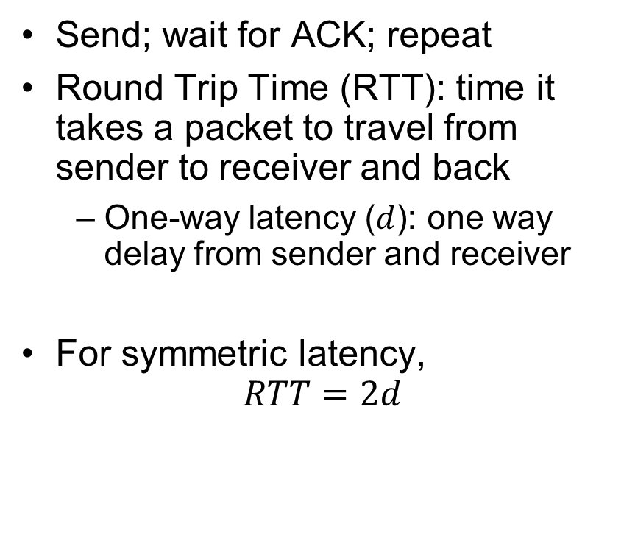
Stop-and-Wait (No Packet Loss)
Send; wait for ACK; repeat
Round Trip Time ($\text{RTT}$): time it takes a packet to travel from sender to receiver and back
One-way latency ($d$): one way delay from sender and receiver
For symmetric latency,
$$RTT=2d$$
Sender
Receiver
1
d
RTT
ACK 1
2
RTT
ACK 2
3
Time

Slide 27
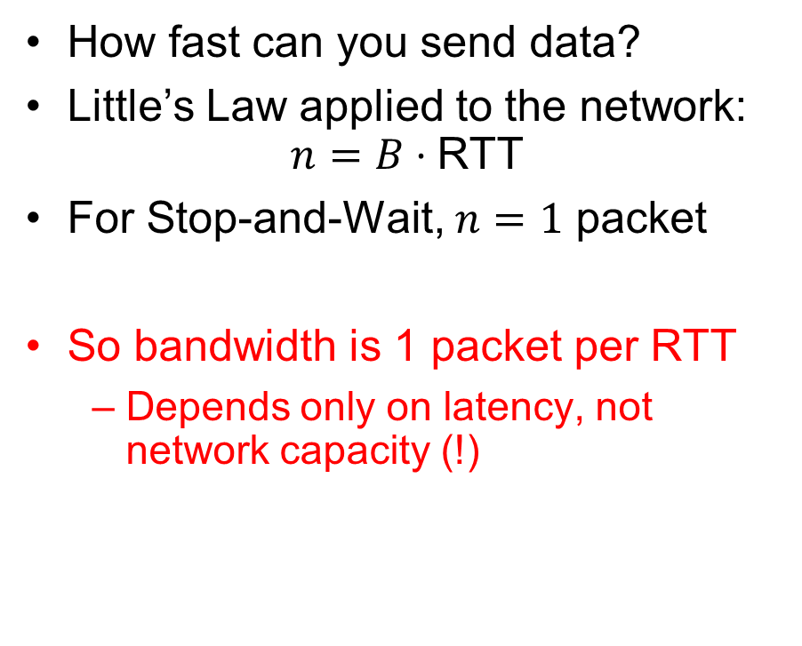
Stop-and-Wait (No Packet Loss)
How fast can you send data?
Little’s Law applied to the network:
$$n=B⋅\text{RTT}$$
For Stop-and-Wait, $n=1$ packet
So bandwidth is 1 packet per RTT
Depends only on latency, not network capacity (!)
Sender
Receiver
1
d
RTT
ACK 1
2
RTT
ACK 2
3
Time

Slide 28
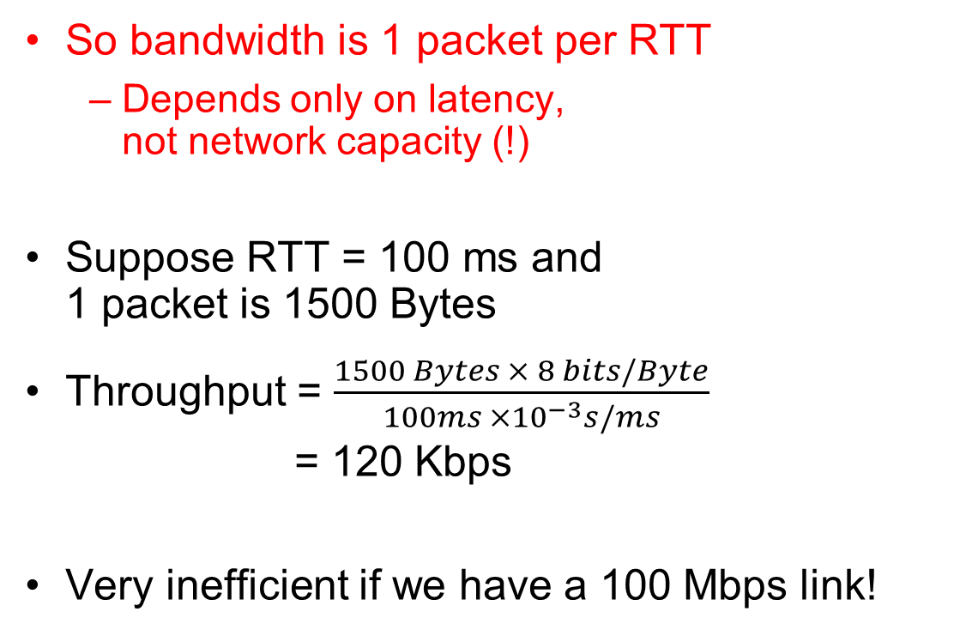
Stop-and-Wait (No Packet Loss)
So bandwidth is 1 packet per RTT
Depends only on latency, not network capacity (!)
Suppose RTT = 100 ms and 1 packet is 1500 Bytes
Throughput = $\frac{1500 Bytes × 8 bits/Byte}{100ms ×{10}^{−3}s/ms}$ = 120 Kbps
Very inefficient if we have a 100 Mbps link!
Sender
Receiver
1
d
RTT
ACK 1
2
RTT
ACK 2
3
Time

Slide 29
Stop-and-Wait with Packet Loss
Loss recovery relies on timeouts
How to choose a good timeout?
Too short – lots of duplication
Too long – packet loss is really disruptive!
How to deal with duplication?
Retransmission certainly opens up the possibility for copies of packets
Sender
Receiver
1
RTT
ACK 1
timeout
1
Time

Slide 30
How to Deal with Message Duplication?
Solution: put sequence number in message to identify re-transmitted packets
Receiver checks for duplicate number’s; Discard if detected
Requirements:
Sender keeps copy of unACK’d messages
Easy: only need to buffer small number of messages
Receiver tracks possible duplicate messages
Hard: when ok to forget about received message?
Alternating-bit protocol:
Send one message at a time; don’t send next message until ACK received
Sender keeps last message; receiver tracks sequence number of last message received
Pros: simple, small overhead
Con: doesn’t work if network can delay or duplicate messages arbitrarily
Sender
Receiver
Pkt #0
ACK #0
Pkt #1
ACK #1
Pkt #0
ACK #0

Slide 31
Advantages of Moving Away From Stop-and-Wait
Larger space of acknowledgements
Pipelining: don’t wait for ACK before sending next packet
ACKs serve dual purpose:
Reliability: Confirming packet received
Ordering: Packets can be reordered at destination
How much data is in flight now?
Bytes in-flight: Wsend = RTT × B
Here B is in “bytes/second”
Wsend ≡ Sender’s “Window Size”
Packets in flight = (Wsend / packet size)
How long does the sender have to keep the packets around?
How long does the receiver have to keep the packets’ data?
What if sender is sending packets faster than the receiver can process the data?
Sender
Receiver
RTT
d
Time

Slide 32
Recall: Communication Between Processes
write(wfd, wbuf, wlen);
Process A
Process B
In-Memory Queue
n = read(rfd,rbuf, rmax);
Data written by A is held in memory until B reads it
Queue has a fixed capacity
Writing to the queue blocks if the queue if full
Reading from the queue blocks if the queue is empty
POSIX provides this abstraction in the form of pipes

Slide 33
Buffering in a TCP Connection
Host 1
Host 2
Process A
Process B
Send Queue
Data (Packets)
Receive Queue
Separate pair of queues per TCP connection
Receive Queue
Data (Packets)
Send Queue
A single TCP connection needs four in-memory queues:
Send buffer: add data on write syscall, remove data when ACK received
Receive buffer: add data when packets received, remove data on read syscall

Slide 34
Window Size: Space in Receive Queue
Host 1
Host 2
Process A
Process B
Send Queue
Data (Packets)
Receive Queue
Separate pair of queues per TCP connection
Receive Queue
Data (Packets)
Send Queue
A host’s window size for a TCP connection is how much remaining space it has in its receive queue
A host advertises its window size in every TCP packet it sends!
Sender never sends more than receiver’s advertised window size

Slide 35
Sliding Window Protocol
TCP sender knows receiver’s window size, and aims never to exceed it
But packets that it previously send may arrive, filling the window size!
Rule: TCP sender ensures that:
Number of Sent but UnACKed Bytes < Receiver’s Advertised Window Size
Can send new packets as long as sent-but-unacked packets haven’t already filled the advertised window size

Slide 36
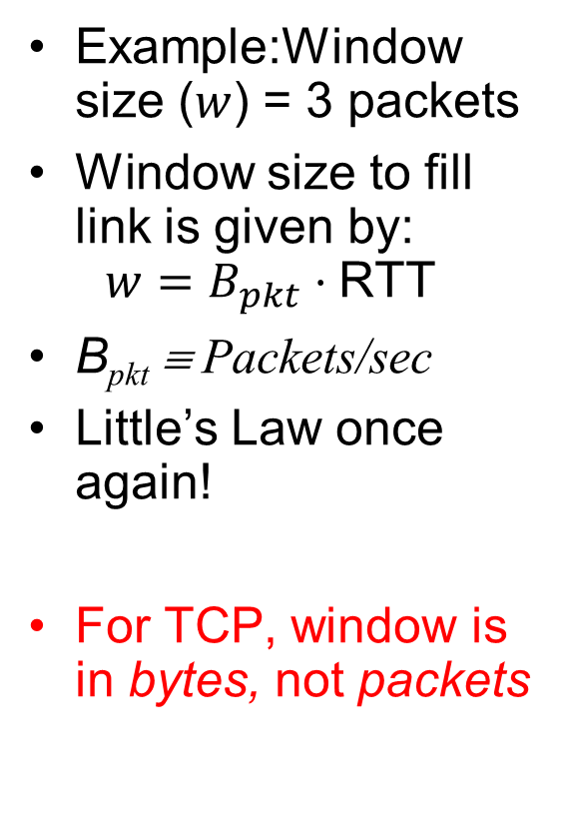
Sliding Window (No Packet Loss)
Example:Window size ($w$) = 3 packets
Window size to fill link is given by: $w=B_{pkt}⋅\text{RTT}$
B_{pkt} ≡ Packets/sec
Little’s Law once again!
For TCP, window is in bytes, not packets
Unacked packets that sender sent
Out-of-seq packets
in receiver’s window
{1}
1
{1, 2}
2
{}
{1, 2, 3}
3
{}
{2, 3, 4}
4
{}
{3, 4, 5}
5
.
.
.
{4, 5, 6}
6
.
.
.
Time
Sender
Receiver

Slide 37
TCP Windows and Sequence Numbers: PER BYTE!
Sequence Numbers
Sent
ACK’d
Sent
not ACK’d
Not yet
sent
Sender
Received
Given to app
Received
Buffered
Not yet
received
Receiver
Sender has three regions:
Sequence regions
sent and ACK’d
sent and not ACK’d
not yet sent
Window (colored region) adjusted by sender
Receiver has three regions:
Sequence regions
received and ACK’d (given to application)
received and buffered
not yet received (or discarded because out of order)

Slide 38
Window-Based Acknowledgements (TCP)
100
140
190
230
260
300
340
380
400
Seq:100
Size:40
Seq:140
Size:50
Seq:190
Size:40
Seq:230
Size:30
Seq:260
Size:40
Seq:300
Size:40
Seq:340
Size:40
Seq:380
Size:20
A:100/300
Seq:100
A:140/260
Seq:140
A:190/210
Seq:230
A:190/210
Seq:260
A:190/210
Seq:300
A:190/210
Retransmit!
Seq:190
A:340/60
Seq:340
A:380/20
Seq:380
A:400/0

Slide 39
Congestion
Too much data trying to flow through some part of the network
IP’s solution: Drop packets
What happens to TCP connection?
Lots of retransmission – wasted work and wasted bandwidth (when bandwidth is scarce)

Slide 40
Congestion Avoidance
Congestion
How long should timeout be for re-sending messages?
Too long → wastes time if message lost
Too short → retransmit even though ACK will arrive shortly
Stability problem: more congestion ⇒ ACK is delayed ⇒ unnecessary timeout ⇒ more traffic ⇒ more congestion
Closely related to window size at sender: too big means putting too much data into network
How does the sender’s window size get chosen?
Must be less than receiver’s advertised buffer size
Try to match the rate of sending packets with the rate that the slowest link can accommodate
Sender uses an adaptive algorithm to decide size of N
Goal: fill network between sender and receiver
Basic technique: slowly increase size of window until acknowledgements start being delayed/lost
TCP solution: “slow start” (start sending slowly)
If no timeout, slowly increase window size (throughput) by 1 for each ACK received
Timeout ⇒ congestion, so cut window size in half
“Additive Increase, Multiplicative Decrease”
Notes:
2nd thing we use window-based acknowledgment protocol for:
Avoid overwhelming network

Slide 41
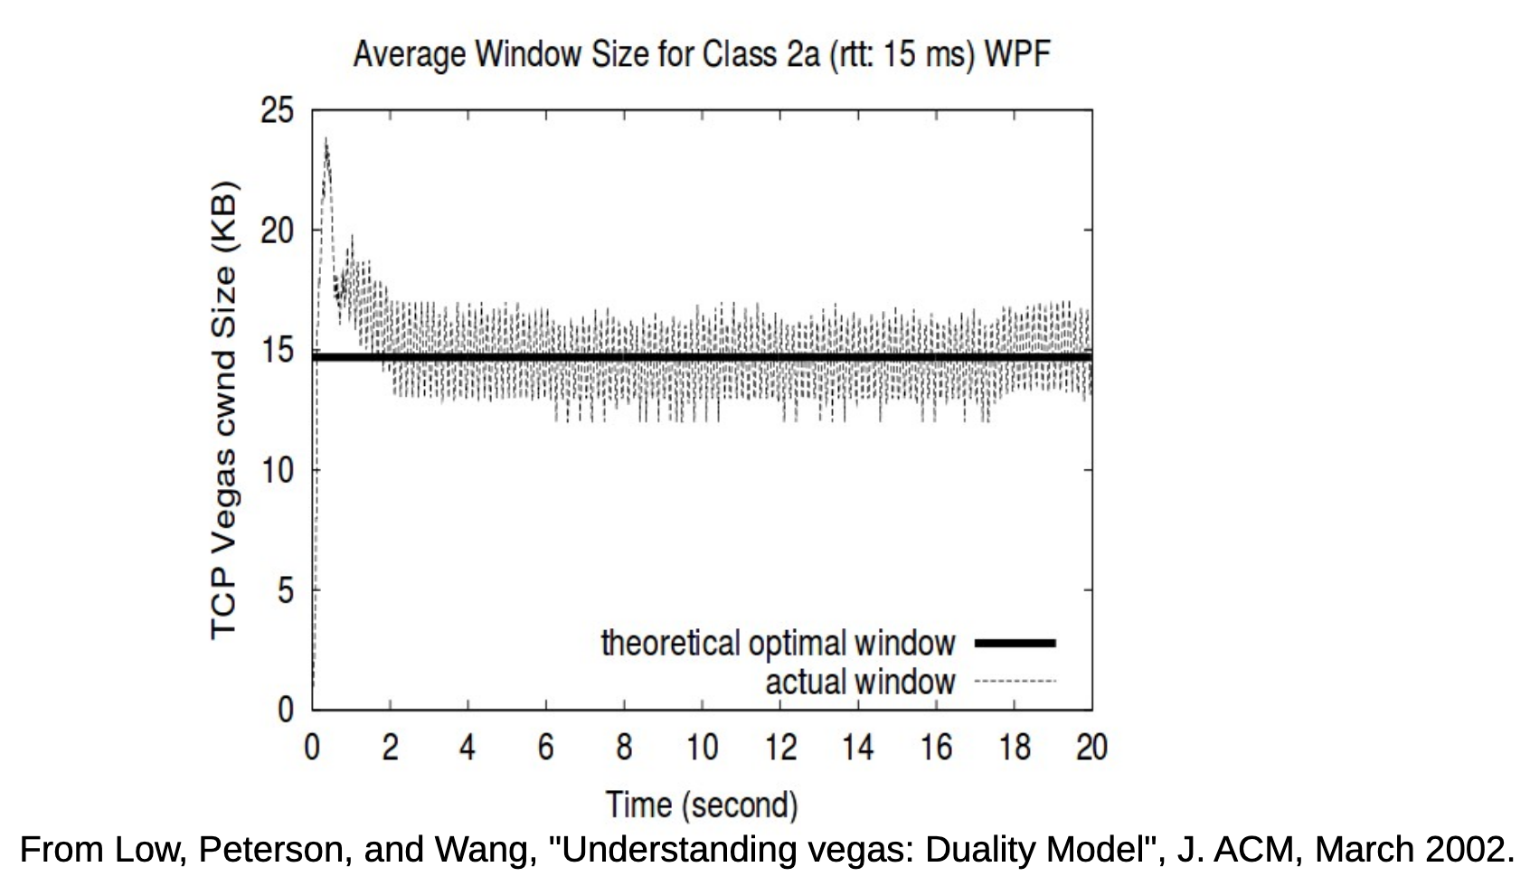
Congestion Management
TCP artificially restricts the window size if it sees packet loss
Careful control loop to make sure:
We don’t send too fast and overwhelm the network
We utilize most of the bandwidth the network has available
In general, these are conflicting goals!

Slide 42
Recall: Connection Setup over TCP/IP
Server
Socket
Request Connection
new
socket
socket
Connection
socket
connection
Client
Server
5-Tuple identifies each connection:
Source IP Address
Destination IP Address
Source Port Number
Destination Port Number
Protocol (always TCP here)
Often, Client Port “randomly” assigned
Done by OS during client socket setup
Server Port often “well known”
80 (web), 443 (secure web), 25 (sendmail), etc
Well-known ports from 0—1023

Slide 43
Establishing TCP Service
Open connection: 3-way handshaking
Need to establish bidirectional communication, including sequence numbers
Reliable byte stream transfer from (IPa, TCP_Port1) to (IPb, TCP_Port2)
Indication if connection fails: Reset
Close (tear-down) connection

Slide 44
Sockets in concept
Client
Server
Create Server Socket
Create Client Socket
Bind it to an Address
(host:port)
Connect it to server (host:port)
Listen for Connection
Accept syscall()
Connection Socket
Connection Socket
write request
read request
read response
write response
Close Client Socket
Close Connection Socket
Close Server Socket

Slide 45
Open Connection: 3-Way Handshake
Client (initiator)
Server
Server calls listen() to wait for a new connection
Client calls connect() providing server’s IP address and port number
Each side sends SYN packet proposing an initial sequence number (one for each sender) and ACKs the other
listen()
connect()
SYN, SeqNum = x
SYN and ACK, SeqNum = y and Ack = x + 1
time
ACK, Ack = y + 1
allocate buffer space,
connection enqueued
accept() dequeues connection

Slide 46
Sockets in concept
Client
Server
Create Server Socket
Create Client Socket
Bind it to an Address
(host:port)
Connect it to server (host:port)
Listen for Connection
Accept syscall()
Connection Socket
Connection Socket
write request
read request
read response
write response
Close Client Socket
Close Connection Socket
Close Server Socket

Slide 47
Close Connection: 4-Way Teardown
Connection is not closed until both sides agree
Host 1
Host 2
close()
FIN
FIN ACK
If multiple FDs on Host 1 refer to this connection, all of them must be closed
Same for close() call on Host 2
Any calls to read() return 0
data
OS discards data (no socket to give it to)
FIN
close()
FIN ACK
OS deallocates connection state
Can retransmit FIN ACK if it is lost
timeout
OS deallocates connection state

Slide 48
Recall: Distributed Applications Build With Messages
How do you actually program a distributed application?
Need to synchronize multiple threads, running on different machines
No shared memory, so cannot use test&set
One Abstraction: send/receive messages
Already atomic: no receiver gets portion of a message and two receivers cannot get same message
Interface:
Mailbox (mbox): temporary holding area for messages
Includes both destination location and queue
Send(message,mbox)
Send message to remote mailbox identified by mbox
Receive(buffer,mbox)
Wait until mbox has message, copy into buffer, and return
If threads sleeping on this mbox, wake up one of them
Send
Network
Receive

Slide 49
Question: Data Representation
An object in memory has a machine-specific binary representation
Threads within a single process have the same view of what’s in memory
Easy to compute offsets into fields, follow pointers, etc.
In the absence of shared memory, externalizing an object requires us to turn it into a sequential sequence of bytes
Serialization/Marshalling: Express an object as a sequence of bytes
Deserialization/Unmarshalling: Reconstructing the original object from its marshalled form at destination

Slide 50
Simple Data Types
uint32_t x;
Suppose I want to write a x to a file
First, open the file: FILE* f = fopen(“foo.txt”, “w”);
Then, I have two choices:
fprintf(f, “%lu”, x);
fwrite(&x, sizeof(uint32_t), 1, f);
Or equivalently, write(fd, &x, sizeof(uint32_t)); (perhaps with a loop to be safe)
Neither one is “wrong” but sender and receiver should be consistent!

Slide 51
Machine Representation
Consider using the machine representation:
fwrite(&x, sizeof(uint32_t), 1, f);
How do we know if the recipient represents x in the same way?
For pipes, is this a problem?
What about for sockets?

Slide 52
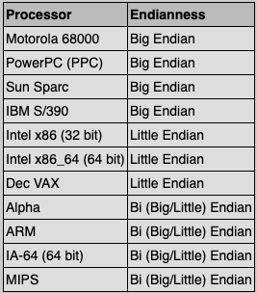
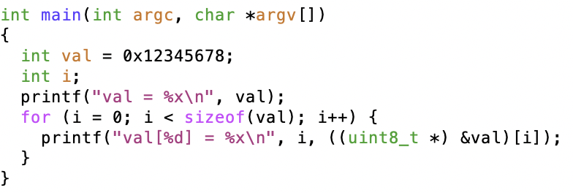
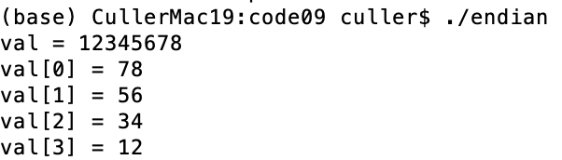
Endianness
For a byte-address machine, which end of a machine-recognized object (e.g., int) does its byte-address refer to?
Big Endian: address is the most-significant bits
Little Endian: address is the least-significant bits

Slide 53
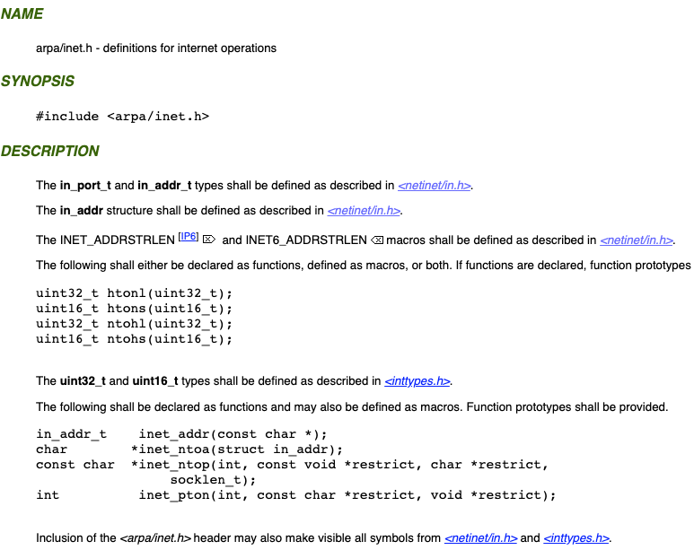
What Endian is the Internet?
Big Endian
Network byte order
Vs. “host byte order”

Slide 54
Dealing with Endianness
Decide on an “on-wire” endianness
Convert from native endianness to “on-wire” endianness before sending out data (serialization/marshalling)
uint32_t htonl(uint32_t) and uint16_t htons(uint16_t) convert from native endianness to network endianness (big endian)
Convert from “on-wire” endianness to native endianness when receiving data (deserialization/unmarshalling)
uint32_t ntohl(uint32_t) and uint16_t ntohs(uint16_t) convert from network endianness to native endianness (big endian)

Slide 55
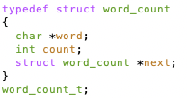
What About Richer Objects?
Consider word_count_t of Homework 0 and 1 …
Each element contains:
An int
A pointer to a string (of some length)
A pointer to the next element
fprintf_words writes these as a sequence of lines (character strings with \n) to a file stream
What if you wanted to write the whole list as a binary object (and read it back as one)?
How do you represent the string?
Does it make any sense to write the pointer?

Slide 56
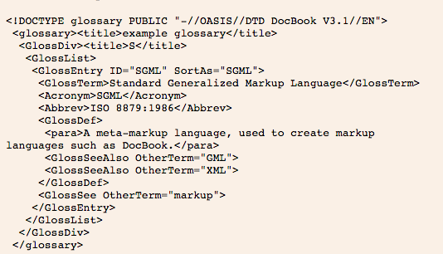
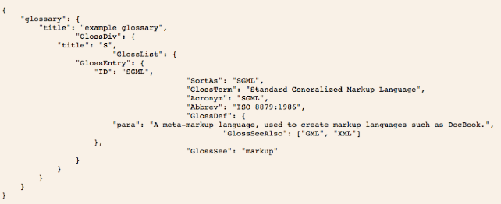
Data Serialization Formats
JSON and XML are commonly used in web applications
Lots of ad-hoc formats

Slide 57
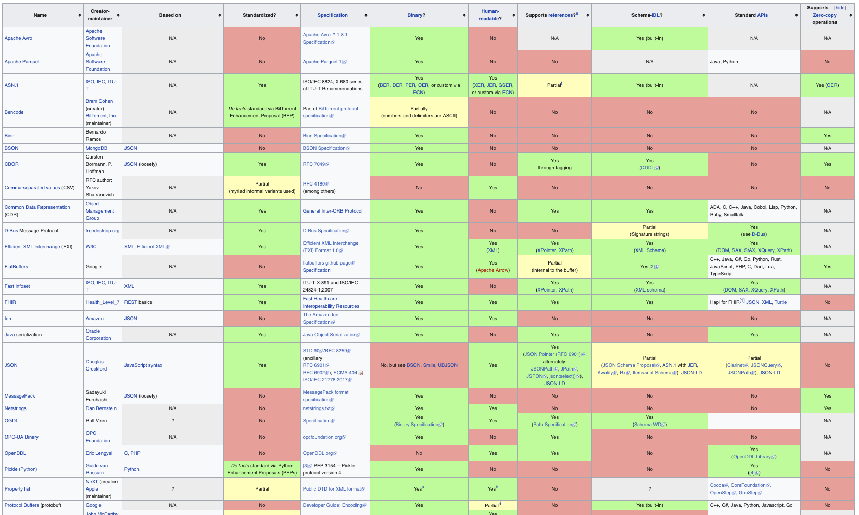
Data Serialization Formats

Slide 58
Remote Procedure Call (RPC)
Raw messaging is a bit too low-level for programming
Must wrap up information into message at source
Must decide what to do with message at destination
May need to sit and wait for multiple messages to arrive
And must deal with machine representation by hand
Another option: Remote Procedure Call (RPC)
Calls a procedure on a remote machine
Idea: Make communication look like an ordinary function call
Automate all of the complexity of translating between representations
Client calls: remoteFileSystem→Read("rutabaga");
Translated automatically into call on server: fileSys→Read("rutabaga");

Slide 59
RPC Concept
bundle
args
Client (caller)
r = f(v1, v2);
call
Client
Stub
send
return
receive
unbundle
ret vals
bundle
ret vals
Server (callee)
res_t f(a1, a2)
return
Server
Stub
send
call
receive
unbundle
args

Slide 60
RPC Information Flow
bundle
args
Client (caller)
r = f(v1, v2);
call
Client
Stub
send
Packet
Handler
return
receive
unbundle
ret vals
Machine A
Network
Network
Machine B
bundle
ret vals
Server (callee)
res_t f(a1, a2)
return
Server
Stub
send
Packet
Handler
Server
Stub
call
receive
unbundle
args
unbundle
args

Slide 61
RPC Implementation
Request-response message passing (under covers!)
“Stub” provides glue on client/server
Client stub is responsible for “marshalling” arguments and “unmarshalling” the return values
Server-side stub is responsible for “unmarshalling” arguments and “marshalling” the return values.
Marshalling involves (depending on system)
Converting values to a canonical form, serializing objects, copying arguments passed by reference, etc.

Slide 62
RPC Details (1/3)
Equivalence with regular procedure call
Parameters ⇔ Request Message
Result ⇔ Reply message
Name of Procedure: Passed in request message
Return Address: mbox2 (client return mail box)
Stub generator: Compiler that generates stubs
Input: interface definitions in an “interface definition language (IDL)”
Contains, among other things, types of arguments/return
Output: stub code in the appropriate source language
Code for client to pack message, send it off, wait for result, unpack result and return to caller
Code for server to unpack message, call procedure, pack results, send them off
Notes:
…
- You might imagine that this stub code, to marshal arguments and make requests over the network, looks similar for many different remote function calls. We can actually generate it automatically, with a compiler!

Slide 63
RPC Details (2/3)
Cross-platform issues:
What if client/server machines are different architectures/ languages?
Convert everything to/from some canonical form
Tag every item with an indication of how it is encoded (avoids unnecessary conversions)
How does client know which mbox (destination queue) to send to?
Need to translate name of remote service into network endpoint (Remote machine, port, possibly other info)
Binding: the process of converting a user-visible name into a network endpoint
This is another word for “naming” at network level
Static: fixed at compile time
Dynamic: performed at runtime

Slide 64
RPC Details (3/3)
Dynamic Binding
Most RPC systems use dynamic binding via name service
Name service provides dynamic translation of service → mbox
Why dynamic binding?
Access control: check who is permitted to access service
Fail-over: If server fails, use a different one
What if there are multiple servers?
Could give flexibility at binding time
Choose unloaded server for each new client
Could provide same mbox (router level redirect)
Choose unloaded server for each new request
Only works if no state carried from one call to next
What if multiple clients?
Pass pointer to client-specific return mbox in request

Slide 65
Problems with RPC: Non-Atomic Failures
Different failure modes in dist. system than on a single machine
Consider many different types of failures
User-level bug causes address space to crash
Machine failure, kernel bug causes all processes on same machine to fail
Some machine is compromised by malicious party
Before RPC: whole system would crash/die
After RPC: One machine crashes/compromised while others keep working
Can easily result in inconsistent view of the world
Did my cached data get written back or not?
Did server do what I requested or not?
Answer? Distributed transactions/Byzantine Commit

Slide 66
Problems with RPC: Performance
RPC is not performance transparent:
Cost of Procedure call « same-machine RPC « network RPC
Overheads: Marshalling, Stubs, Kernel-Crossing, Communication
Programmers must be aware that RPC is not free
Caching can help, but may make failure handling complex

Slide 67
Cross-Domain Communication/Location Transparency
How do address spaces communicate with one another?
Shared Memory with Semaphores, monitors, etc…
File System
Pipes (1-way communication)
“Remote” procedure call (2-way communication)
RPC’s can be used to communicate between address spaces on different machines or the same machine
Services can be run wherever it’s most appropriate
Access to local and remote services looks the same
Examples of RPC systems:
CORBA (Common Object Request Broker Architecture)
DCOM (Distributed COM)
RMI (Java Remote Method Invocation)

Slide 68
Microkernel operating systems
Example: split kernel into application-level servers.
File system looks remote, even though on same machine
Why split the OS into separate domains?
Fault isolation: bugs are more isolated (build a firewall)
Enforces modularity: allows incremental upgrades of pieces of software (client or server)
Location transparent: service can be local or remote
For example in the X windowing system: Each X client can be on a separate machine from X server; Neither has to run on the machine with the frame buffer.
App
App
App
App
File
sys
windows
file system
Windowing
address
spaces
RPC
VM
Networking
Threads
threads
Monolithic Structure
Microkernel Structure

Slide 69


Network-Attached Storage and the CAP Theorem
Network
Consistency:
Changes appear to everyone in the same serial order
Availability:
Can get a result at any time
Partition-Tolerance
System continues to work even when network becomes partitioned
Consistency, Availability, Partition-Tolerance (CAP) Theorem: Cannot have all three at same time
Otherwise known as “Brewer’s Theorem”

Slide 70

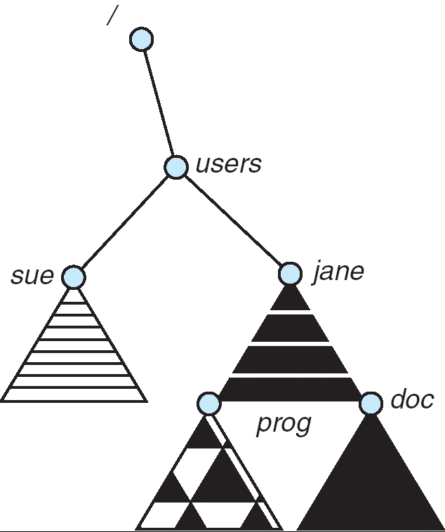
Distributed File Systems
Read File
Network
Data
Client
Server
mount
adj:/jane
Transparent access to files stored on a remote disk
Mount remote files into your local file system
Directory in local file system refers to remote files
e.g., /users/jane/prog/foo.c on laptop actually refers to /prog/foo.c on adj.cs.berkeley.edu
Naming Choices:
[Hostname,localname]: Filename includes server
No location or migration transparency, except through DNS remapping
A global name space: Filename unique in “world”
Can be served by any server
mount
coeus:/sue
mount
adj:/prog

Slide 71

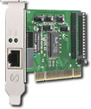
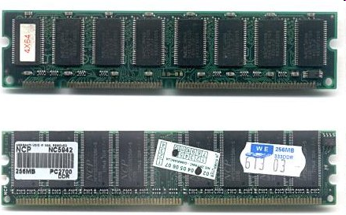
Enabling Design: VFS
The System Call Interface
Process
Management
Memory Management
Filesystems
Device Control
Networking
Concurrency, multitasking
Virtual memory
Files and dirs: the VFS
TTYs and device access
Connectivity
Architecture
Dependent
Code
Memory Manager
File System Types
Device Control
Network Subsystem
Block Devices
IF drivers

Slide 72
Recall: Layers of I/O…
User App:
length = read(input_fd, buffer, BUFFER_SIZE);
User library:
ssize_t read(int, void *, size_t) {
marshal args into registers
issue syscall
register result of syscall to rtn value
};
Application / Service
High Level I/O
Low Level I/O
Exception U→K, interrupt processing
Syscall
void syscall_handler (struct intr_frame *f) {
unmarshall call#, args from regs
dispatch : handlers[call#](args)
marshal results fo syscall ret
}
File System
I/O Driver
ssize_t vfs_read(struct file *file, char __user *buf, size_t count, loff_t *pos) {
User Process/File System relationship
call device driver to do the work
}
Device Driver

Slide 73
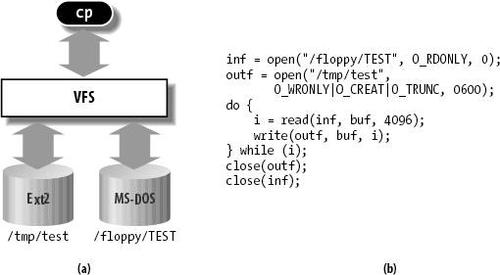
Virtual Filesystem Switch
VFS: Virtual abstraction similar to local file system
Provides virtual superblocks, inodes, files, etc
Compatible with a variety of local and remote file systems
provides object-oriented way of implementing file systems
VFS allows the same system call interface (the API) to be used for different types of file systems
The API is to the VFS interface, rather than any specific type of file system

Slide 74
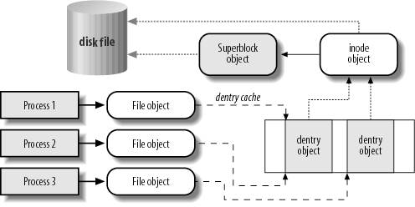
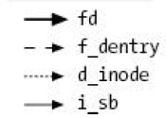
VFS Common File Model in Linux
Four primary object types for VFS:
superblock object: represents a specific mounted filesystem
inode object: represents a specific file
dentry object: represents a directory entry
file object: represents open file associated with process
There is no specific directory object (VFS treats directories as files)
May need to fit the model by faking it
Example: make it look like directories are files
Example: make it look like have inodes, superblocks, etc.

Slide 75
Simple Distributed File System
Read (RPC)
Return (Data)
Client
Write (RPC)
Server
cache
ACK
Client
Remote Disk: Reads and writes forwarded to server
Use Remote Procedure Calls (RPC) to translate file system calls into remote requests
No local caching, but can be cache at server-side
Advantage: Server provides consistent view of file system to multiple clients
Problems? Performance!
Going over network is slower than going to local memory
Lots of network traffic/not well pipelined
Server can be a bottleneck

Slide 76
Use of caching to reduce network load
Crash!
Crash!
read(f1)
→V1
cache
Read (RPC)
read(f1)→V1
read(f1)→V1
F1:V1
Return (Data)
read(f1)→V1
Client
cache
Write (RPC)
Server
F1:V1
F1:V2
ACK
cache
write(f1)
→OK
F1:V2
read(f1)→V2
Client
Idea: Use caching to reduce network load
In practice: use buffer cache at source and destination
Advantage: if open/read/write/close can be done locally, don’t need to do any network traffic…fast!
Problems:
Failure:
Client caches have data not committed at server
Cache consistency!
Client caches not consistent with server/each other

Slide 77
Dealing with Failures
What if server crashes? Can client wait until it comes back and just continue making requests?
Changes in server's cache but not in disk are lost
What if there is shared state across RPC's?
Client opens file, then does a seek
Server crashes
What if client wants to do another read?
Similar problem: What if client removes a file but server crashes before acknowledgement?

Slide 78
Stateless Protocol
Stateless Protocol: A protocol in which all information required to service a request is included with the request
Even better: Idempotent Operations – repeating an operation multiple times is same as executing it just once (e.g., storing to a mem addr.)
Client: timeout expires without reply, just run the operation again (safe regardless of first attempt)
Recall HTTP: Also a stateless protocol
Include cookies with request to simulate a session

Slide 79
Case Study: Network File System (NFS)
Three Layers for NFS system
UNIX file-system interface: open, read, write, close calls + file descriptors
VFS layer: distinguishes local from remote files
Calls the NFS protocol procedures for remote requests
NFS service layer: bottom layer of the architecture
Implements the NFS protocol
NFS Protocol: RPC for file operations on server
XDR Serialization standard for data format independence
Reading/searching a directory
manipulating links and directories
accessing file attributes/reading and writing files
Write-through caching: Modified data committed to server’s disk before results are returned to the client
lose some of the advantages of caching
time to perform write() can be long
Need some mechanism for readers to eventually notice changes! (more on this later)

Slide 80
NFS Continued
NFS servers are stateless; each request provides all arguments require for execution
E.g. reads include information for entire operation, such as ReadAt(inumber,position), not Read(openfile)
No need to perform network open() or close() on file – each operation stands on its own
Idempotent: Performing requests multiple times has same effect as performing them exactly once
Example: Server crashes between disk I/O and message send, client resend read, server does operation again
Example: Read and write file blocks: just re-read or re-write file block – no other side effects
Example: What about “remove”? NFS does operation twice and second time returns an advisory error
Failure Model: Transparent to client system
Is this a good idea? What if you are in the middle of reading a file and server crashes?
Options (NFS Provides both):
Hang until server comes back up (next week?)
Return an error. (Of course, most applications don’t know they are talking over network)

Slide 81
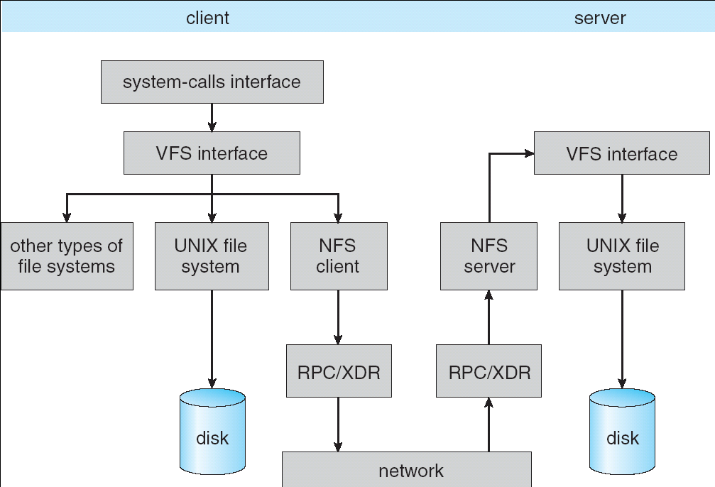
NFS Architecture

Slide 82
NFS Cache consistency
NFS protocol: weak consistency
Client polls server periodically to check for changes
Polls server if data hasn’t been checked in last 3-30 seconds (exact timeout it tunable parameter).
Thus, when file is changed on one client, server is notified, but other clients use old version of file until timeout.
What if multiple clients write to same file?
In NFS, can get either version (or parts of both)
Completely arbitrary!
cache
F1 still ok?
F1:V2
F1:V1
No: (F1:V2)
Client
cache
Write (RPC)
Server
F1:V2
ACK
cache
F1:V2
Client

Slide 83
Sequential Ordering Constraints
What sort of cache coherence might we expect?
i.e. what if one CPU changes file, and before it’s done, another CPU reads file?
Example: Start with file contents = “A”
What would we actually want?
Assume we want distributed system to behave exactly the same as if all processes are running on single system
If read finishes before write starts, get old copy
If read starts after write finishes, get new copy
Otherwise, get either new or old copy
For NFS:
If read starts more than 30 seconds after write, get new copy; otherwise, could get partial update
Client 1:
Read: gets A
Write B
Read: parts of B or C
Client 2:
Read: gets A or B
Write C
Client 3:
Read: parts of B or C
Time

Slide 84
NFS Pros and Cons
NFS Pros:
Simple, Highly portable
NFS Cons:
Sometimes inconsistent!
Doesn’t scale to large # clients
Must keep checking to see if caches out of date
Server becomes bottleneck due to polling traffic

Slide 85
Andrew File System
Andrew File System (AFS, late 80’s) → DCE DFS (commercial product)
Callbacks: Server records who has copy of file
On changes, server immediately tells all with old copy
No polling bandwidth (continuous checking) needed
Write through on close
Changes not propagated to server until close()
Session semantics: updates visible to other clients only after the file is closed
As a result, do not get partial writes: all or nothing!
Although, for processes on local machine, updates visible immediately to other programs who have file open
In AFS, everyone who has file open sees old version
Don’t get newer versions until reopen file

Slide 86
Andrew File System (con’t)
Data cached on local disk of client as well as memory
On open with a cache miss (file not on local disk):
Get file from server, set up callback with server
On write followed by close:
Send copy to server; tells all clients with copies to fetch new version from server on next open (using callbacks)
What if server crashes? Lose all callback state!
Reconstruct callback information from client: go ask everyone “who has which files cached?”
AFS Pro: Relative to NFS, less server load:
Disk as cache ⇒ more files can be cached locally
Callbacks ⇒ server not involved if file is read-only
For both AFS and NFS: central server is bottleneck!
Performance: all writes→server, cache misses→server
Availability: Server is single point of failure
Cost: server machine’s high cost relative to workstation

Slide 87
Summary (1/2)
TCP: Reliable byte stream between two processes on different machines over Internet (read, write, flush)
Uses window-based acknowledgement protocol
Congestion-avoidance dynamically adapts sender window to account for congestion in network
Remote Procedure Call (RPC): Call procedure on remote machine or in remote domain
Provides same interface as procedure
Automatic packing and unpacking of arguments without user programming (in stub)
Adapts automatically to different hardware and software architectures at remote end

Slide 88
Summary (2/2)
Distributed File System:
Transparent access to files stored on a remote disk
Caching for performance
VFS: Virtual File System layer (Or Virtual Filesystem Switch)
Provides mechanism which gives same system call interface for different types of file systems
Cache Consistency: Keeping client caches consistent with one another
If multiple clients, some reading and some writing, how do stale cached copies get updated?
NFS: check periodically for changes
AFS: clients register callbacks to be notified by server of changes

